Slide 1
What’s new in the 2023 edition

Slide 2
What’s new in the 2023 edition
Three major areas of change​
Main change in scope​
Main changes in organisation of stroke services​
Main changes in acute care​
Main changes in rehabilitation and recovery​
Main changes in long-term management and secondary prevention​

Slide 3
Three major areas of change
More than half of recommendations are new or updated since 2016 edition
Big changes in evidence base means significant updates in three main areas:
  Big expansion of patient groups eligible for thrombolysis and thrombectomy
  More intensive interventions in secondary prevention – antiplatelets, cholesterol, blood pressure
  More intensive rehab in hospital and at home to promote motor and language recovery
Main changes across whole guideline in more detail on next slides.

Slide 4

Main change in scope
‘Five nations’ guideline for first time, covering:
  England
  Wales
  Scotland
  Northern Ireland
  Republic of Ireland
Endorsed for use in clinical practice by:
  Royal College of Physicians of London
  Scottish Intercollegiate Guidelines Network (SIGN)
  Royal College of Physicians of Ireland

Slide 5
Main changes in organisation of stroke services (1)
Updated recommended levels of specialist medical, nursing & rehabilitation staff for hyperacute, acute & rehabilitation stroke services
A stroke rehabilitation unit should have access to a consultant specialising in stroke rehabilitation (medical or non-medical, i.e. nurse or therapist, where professional regulation permits).
Stroke rehabilitation units with non-medical consultant leadership should have daily medical cover (ward doctors, GPs), enabling admissions and discharges 7 days a week.
People undergoing rehabilitation after stroke who are not eligible for early supported discharge should be referred to community stroke rehabilitation if they have ongoing rehabilitation needs when transferred from hospital.

Slide 6
Main changes in organisation of stroke services (2)
The intensity and duration of intervention provided by the community stroke rehabilitation team should be established between the stroke specialist and the person with stroke and be based on clinical need tailored to goals and outcomes.
A multidisciplinary service providing early supported discharge and community stroke rehabilitation should adopt a minimum core team structure.
In the case of people with stroke with limited life expectancy, the multidisciplinary team should establish whether there is any existing documentation of the patient’s wishes regarding management of risks associated with continued eating and drinking.

Slide 7
Main changes in acute care (1)
Dual antiplatelet therapy with either aspirin and clopidogrel, or aspirin and ticagrelor, should be considered in patients presenting with 24 hours of TIA and minor stroke.
Patients with acute ischaemic stroke within 4.5 hours of known onset should be considered for thrombolysis with alteplase or tenecteplase.
Patients with acute ischaemic stroke who were last known to be well more than 4.5 hours earlier should be considered for thrombolysis with alteplase between 4.5-9 hours of known onset, if there is evidence of the potential to salvage brain tissue on CT perfusion or MRI (DWI-FLAIR mismatch).
Patients eligible for mechanical thrombectomy should receive prior intravenous thrombolysis as rapidly as possible (unless contraindicated), irrespective of whether presented to an acute stroke centre or a thrombectomy centre.

Slide 8
Main changes in acute care (2)
Patients presenting with acute anterior circulation ischaemic stroke and large artery occlusion between 6 and 24 hours previously, including wake-up stroke, should receive mechanical thrombectomy on basis of a combination of ASPECTS score and target or clinical imaging mismatch.
Patients presenting with acute ischaemic stroke in the posterior circulation within 12 hours of onset should be considered for mechanical thrombectomy if they have a confirmed intracranial vertebral or basilar artery occlusion.
Patients with acute spontaneous intracerebral haemorrhage with a systolic BP of 150-220 mmHg should be considered for urgent treatment within 6 hours of symptom onset, aiming to achieve a systolic BP of 130-139 mmHg within one hour and sustained for at least 7 days.
Early non-invasive cerebral angiography (CTA/MRA within 48 hours of onset) should be considered for patients with acute spontaneous intracerebral haemorrhage wherea macrovascular cause is likely to be identified.

Slide 9
Main changes in rehabilitation and recovery (1)
People with stroke should be considered to have the potential to benefit from rehabilitation at any point after their stroke.
People with stroke should be routinely screened for delirium.
People with stroke should be screened for cognitive problems as soon as it is medically appropriate and they are able to participate in a brief interaction, usually within the initial days after onset of stroke.
People with stroke should be routinely screened for anxiety and depression using standardised tools; the results of which should be used alongside other sources of information.
People with motor recovery goals following stroke should receive at least 3 hours a day of therapy (therapist-delivered) and should be supported to remain active for up to 6 hours a day.
For people with stroke who show diminished motivation, reduced goal-directed behaviour or decreased emotional responsiveness that is persistent and affects engagement with rehabilitation or functional recovery, apathy should be considered alongside other cognitive and mood disorders.

Slide 10
Main changes in rehabilitation and recovery (2)
People with some upper limb movement, or impaired mobility or balance after stroke, should be offered repetitive task practice as the principal rehabilitation approach, in preference to other therapy approaches including Bobath.
People with mild-moderate arm weakness after stroke may be considered for transcutaneous vagus nerve stimulation in addition to usual therapy. Implanted vagus nerve stimulation should only be used in the context of a clinical trial.
Stroke rehabilitation services should ensure they have adequate equipment, including the technology requirements to provide telerehabilitation, to enable provision of the treatments recommended within the guideline.
Stroke services should consider building links with recreational fitness facilities such as gyms or leisure centres, or providing equipment in outpatient departments, to enable people with stroke to access treadmills and other relevant fitness equipment.

Slide 11
Main changes in rehabilitation and recovery (3)
People with stroke should be offered cardiorespiratory training or mixed training once they are medically stable, regardless of age, time since stroke and severity of impairment.
People with stroke should be assessed and periodically reviewed for post-stroke fatigue, including for factors that might precipitate or exacerbate fatigue (e.g. depression and anxiety, sleep disorders, pain) and these factors should be addressed accordingly. Appropriate time points for review are at discharge from hospital and then at regular intervals, including at 6 months and annually thereafter.
People with aphasia after stroke should be given the opportunity to improve their language and communication abilities as frequently and for as long as they continue to make meaningful gains, including access to appropriate practice-based digital therapies.

Slide 12
Main changes in long-term management and secondary prevention (1)
Home blood pressure monitoring should be considered for guiding the management of BP-lowering treatment, with a typical home systolic BP target below 125 mmHg.
Lipid-lowering treatment for people with ischaemic stroke or TIA and evidence of atherosclerosis should aim to reduce fasting LDL-cholesterol below 1.8 mmol/L (equivalent to a non-HDL-cholesterol below 2.5 mmol/L in a non-fasting sample).
People who have an intracerebral haemorrhage whilst taking an antithrombotic medication to prevent vascular occlusive events may be considered for restarting antiplatelet treatment.
People with ischaemic stroke and atrial fibrillation or flutter should be considered for anticoagulation within 5 days of onset for mild stroke and may be considered for anticoagulation from 5-14 days of onset for moderate to severe stroke. Wherever possible people in the latter category should be offered participation in a trial of the timing of initiation of anticoagulation after stroke.

Slide 13
Main changes in long-term management and secondary prevention (2)
Selected people below the age of 60 with ischaemic stroke or TIA of otherwise undetermined aetiology, in association with a patent foramen ovale (PFO) and a right-to-left shunt or an atrial septal aneurysm, should be considered for endovascular PFO device closure within 6 months of the index event to prevent recurrent stroke.
People with lobar intracerebral haemorrhage (ICH) associated with probable cerebral amyloid angiopathy (CAA) may be considered for antiplatelet therapy for the secondary prevention of vaso-occlusive events, and those with atrial fibrillation (AF) may be considered for oral anticoagulation. Wherever possible these people should be offered participation in a randomised controlled trial of antithrombotic treatment after ICH associated with CAA.
People with CADASIL should be considered for intensive cardiovascular risk factor management, including antiplatelet therapy to prevent secondary vascular events.

Slide 14
Main changes in long-term management and secondary prevention (3)
In people with ischaemic stroke or TIA requiring antithrombotic treatment the presence of cerebral microbleeds (regardless of number or distribution) need not preclude the use of such treatment.
People with stroke should be offered cardiorespiratory training or mixed training, for at least 30-40 minutes, 3 to 5 times a week for 10-20 weeks regardless of age, time since stroke onset or severity of impairments, guided by their goals and preferences.
People with stroke should be supported to develop their own self-management plan, based on their individual needs, goals, preferences and circumstances.

Slide 15
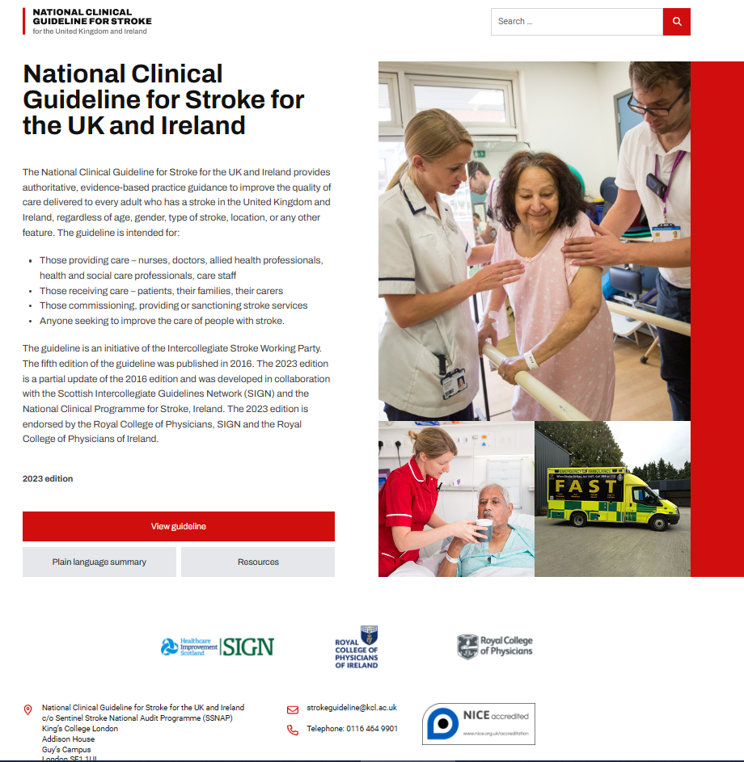
All this and much more
now available at
www.strokeguideline.org
Along with
a plain language summary
for people affected by stroke

